Slide 1
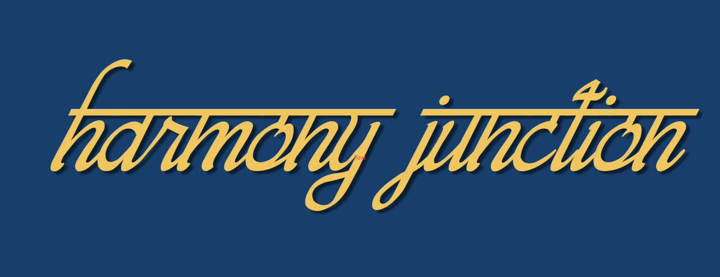
East West Fusion Song Resource
Creative Cross Currents with India & Sri Lanka at Dimbola Museums & Gallery

Slide 2
Song Structure & Lyrics (Listen HERE)
Intro (free improvised vocal and harmonies and notes of the Rag/scale)
Verse 1
Naya Raasta, Naya Caravaan
Nayeen Manzilein Sub Hain Yahaan
Rutututanana deridumtanana rututanana x 2
Verse 2
Naya Raasta, Naya Caravaan
Nayeen Manzilein Sub Hain Yahaan
Sur Taal Ka Aadaan Pradaan,
Aao Karein Sub Mil Yahaan
Rutututanana deridumtanana rututanana x 4

Slide 3
With Call & Response
Naya Raasta, (Naya Raasta) Naya Caravaan (Naya Caravaan)
Nayeen Manzilein (Neyeen Manzilein) Sub Hain Yahaan (Sub Hain Yahaan)
Sur Taal Ka (Sur Taal Ka), Aadaan Pradaan (Aadaan Pradaan)
Aao Karein (Aao Karein) Sub Mil Yahaan (Sub Mil Yahaan)
Tempo Change
Naya Raasta, (Naya Raasta) Naya Caravaan (Naya Caravaan)
Nayeen Manzilein (Neyeen Manzilein) Sub Hain Yahaan (Sub Hain Yahaan)
Sur Taal Ka (Sur Taal Ka), Aadaan Pradaan (Aadaan Pradaan)
Aao Karein (Aao Karein) Sub Mil Yahaan (Sub Mil Yahaan)

Slide 4
Outro with Surgam
Rutututanana deridumtanana rututanana x 3
ṆiRe GaRe Sa
Rutututanana deridumtanana rututanana
ṆiRe GaRe Sa
Rutututanana deridumtanana rututanana
ṆiRe GaRe Ga
Rutututanana deridumtanana rututanana
ṆiRe GaRe Ga
Rutututanana deridumtanana rututanana
GaRe ṆiRe Ga
Rutututanana deridumtanana rututanana
PaMa GaRa Sa

Slide 5
Hindi Translation & Meaning
Verse 1
Naya Raasta, Naya Caravaan
Nayeen Manzilein Sub Hain Yahaan
Meaning: Sailing towards a new horizon in search of new destinations
Syllables
Rutututanana deridumtanana rututanana x 2
Meaning: Joyful Music and Rhythm
Verse 2
Sur Taal Ka Aadaan Pradaan,
Aao Karein Sub Mil Yahaan
Meaning: Exchanging and creating new melodies and rhythms together

Slide 6
Eastern and Western Musical Features
Eastern
Language: Hindi
Instruments: Harmonium, Tabla & Voice
Tarana Syllables: Tanana & Deridum
Ornamentation through Sargams
Shades of Rag Yaman & Bilaval
Western
Western Choral Harmonies (upper & lower)
Instruments: Piano, Voice
Structure: Verse/Refrain
Call and response
Key Signature: C Sharp Major

Slide 7
Learning Journey (Tution video HERE)
Using the video guide start by the learning the sections of the song in the following order. Additional harmonies and added layers for more able or confident groups come later if you would like to add them in but they are optional:
1 Hindi pronunciation Verse 1
2 Melody Verse 1
3 Syllables pronunciation
4 Melody syllables
5 Hindi pronunciation Verse 2
6 Melody Verse 2
7 Call and response harmony
8 Upper harmonies (melody, syllables & ending)
9 Surgam notes in the outro (for very able singers)
10 Practice with the performance video version HERE

